Slide 1
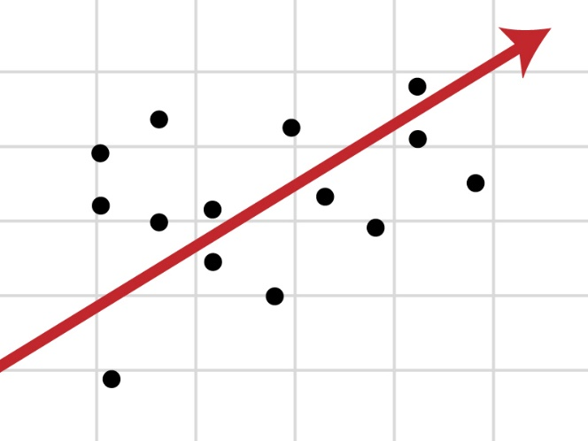
Regression Models
Taking our first steps to modelling data
Yordan Darakchiev
Technical Trainer
iordan93@gmail.com

Slide 2
sli.do #DataScience

Slide 3
Table of Contents
Problem overview
Regression, classification
Machine learning: putting it all together
Linear regression
Motivation, derivation, usage
More involved example
Logistic regression
Motivation, usage

Slide 4
Problem Overview
Types of modelling
1

Slide 5
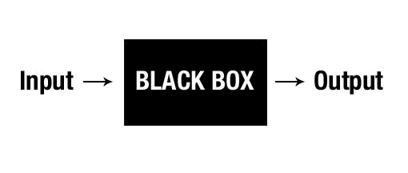
Data Modelling
As part of the data science process, we want to get a clear idea of what processes generate our data
Scientific method: Form a hypothesis and test it
Extension: Find a way to understand what’s in the data
We already did this a lot of times: "mental models" captured our ideas
A stricter way of modelling
Treat the data generating process as a function
"Black box"
Make some assumptions
Create a simplified version of reality under your assumptions
Check your model against reality
Create better and more complex models
5

Slide 6
A Quick Peek at Machine Learning
Machine learning is "making computers learn with experience, without being explicitly programmed"
Similar to how humans learn
It's all about models
ML follows the same processes as we’re going to do
ML algorithms are basically "function approximations"
Each algorithm does its own thing, i.e. has different assumptions, scope and performance
It's also about selecting the best model
There are many "helper algorithms" to do so – either fully automated or semi-automated
Visualization algorithms,
Fine-tuning algorithms
Model selection algorithms, etc.
6

Slide 7
A Quick Peek at Machine Learning (2)
There are a lot of classes of problems
The most commonly used two
Regression – model a function which returns a number (i.e. returns a continuous variable)
Example: predict the temperature tomorrow
Classification – model a function which tries to differentiate between two (or more) predefined types of things
Example: predict if an image is of a cat or not
The essence: once we assume a model, we can make predictions about function outputs
Thus, we can capture patterns in an otherwise unpredictable world
7

Slide 8
Linear Regression
Predict continuous values… and torture first-semester students
7

Slide 9
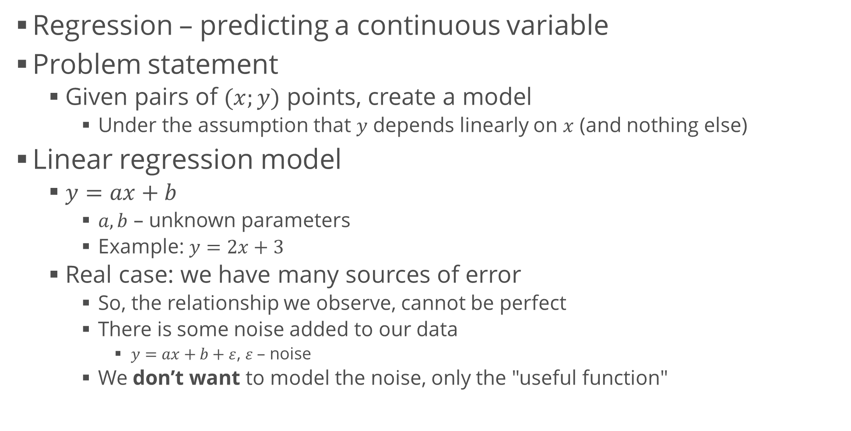
Linear Regression Intuition
7

Slide 10
Generating Data Points
Generating a few "ideal" data points is easy
Adding noise – draw from a random distribution
If we want, we can even configure the "size" of our noise
More noise = worse data = less accurate predictions
x = np.linspace(-3, 5, 10)
y = 2 * x + 3
plt.scatter(x, y)
plt.xlabel("x")
plt.ylabel("y")
plt.show()
y_noise = np.random.normal(size = len(y))
y_with_noise = y + y_noise
plt.scatter(x, y_with_noise)
plt.xlabel("x")
plt.ylabel("y")
plt.show()
10

Slide 11
First Attempt at Modelling
We know the process was linear
Why don't we simply guess a few functions?
Remember: what we need to know are the parameters and
We can see that some functions perform much better than others
Idea: the best function lies "closest" to all points
Meaning
Try to measure the distances from all points to the line
See when these distances are smallest
This will be the best line
for y_guess in [3 * x + 8, 4 * x + 3, -2 * x]:
plt.scatter(x, y_with_noise)
plt.plot(x, y_guess)
plt.show()
11

Slide 12
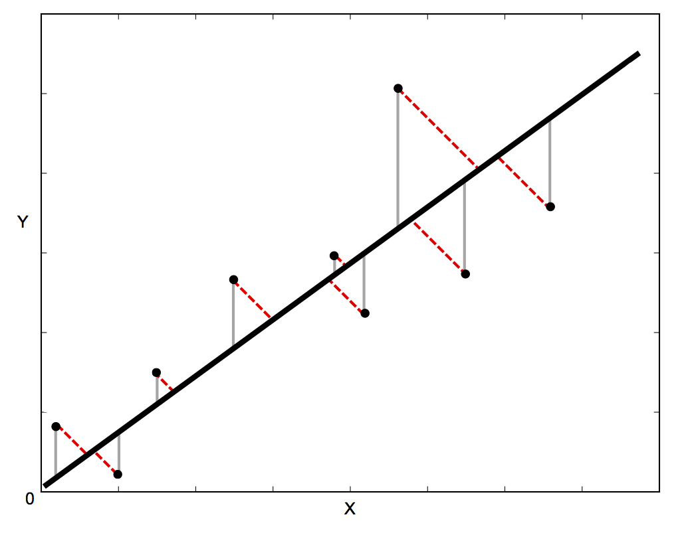
Distances
By definition, the distance from a point to the line is measured on the perpendicular from to
Red dashed lines
This is correct but very computationally expensive
Another approach: consider vertical distances
Gray solid lines
Equivalent measures (for our purposes)
You can prove it to yourself
12

Slide 13
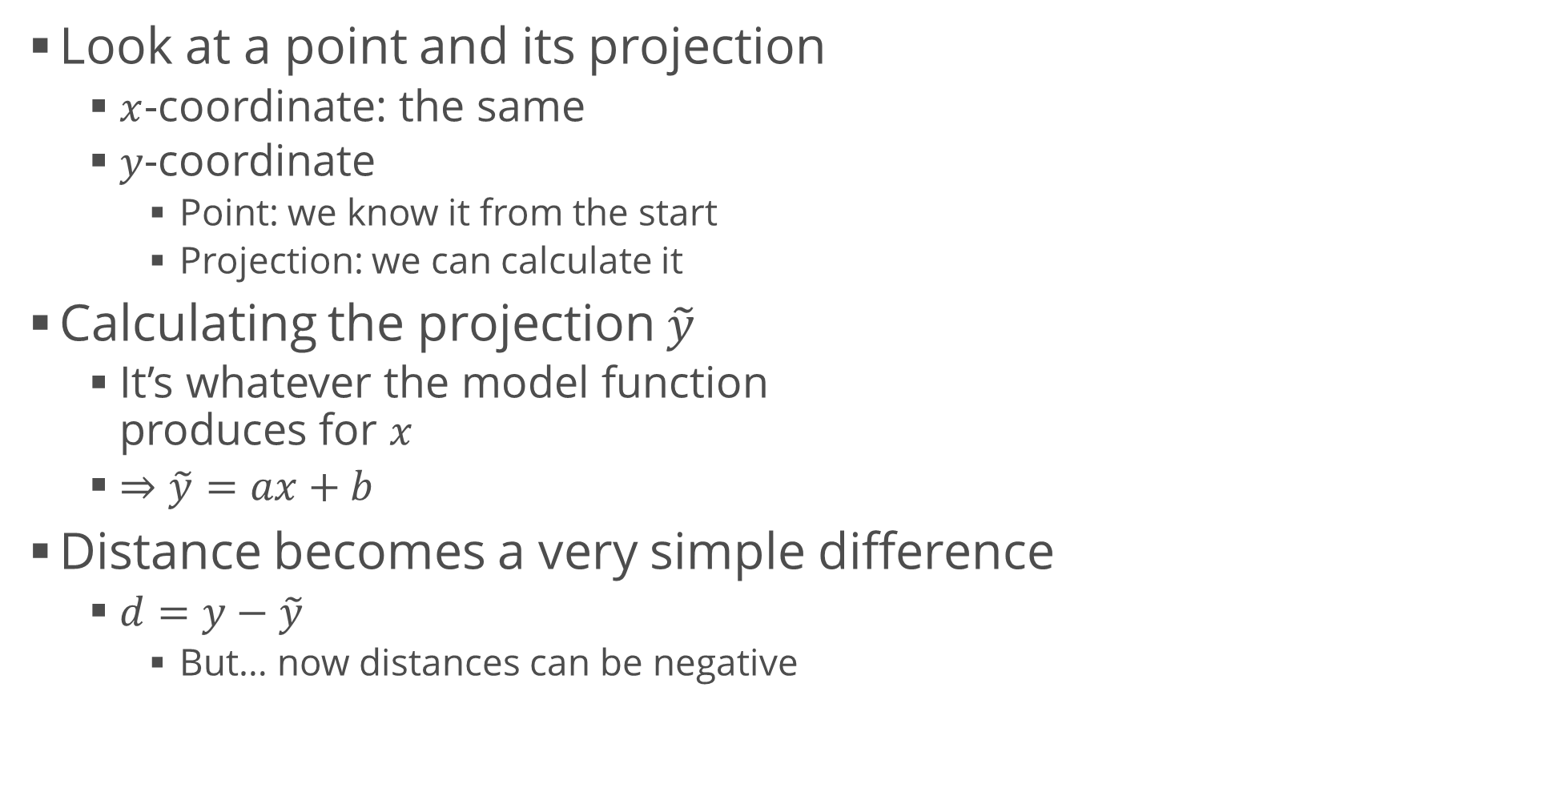
Distances (2)
12

Slide 14
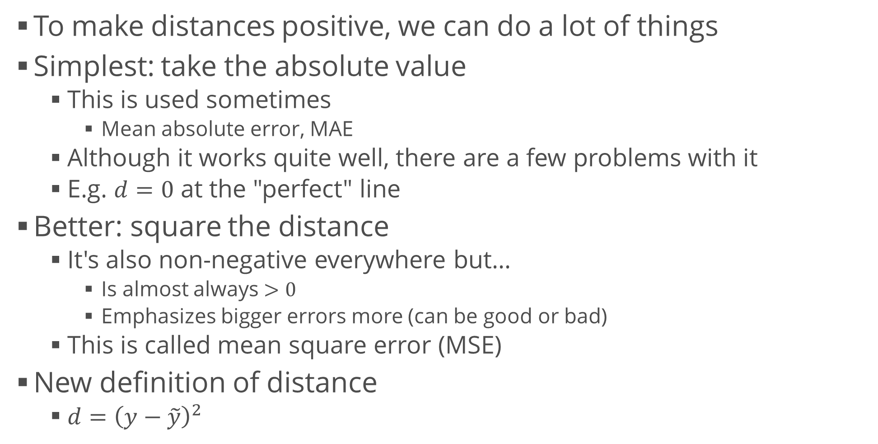
Distances (3)
<number>

Slide 15
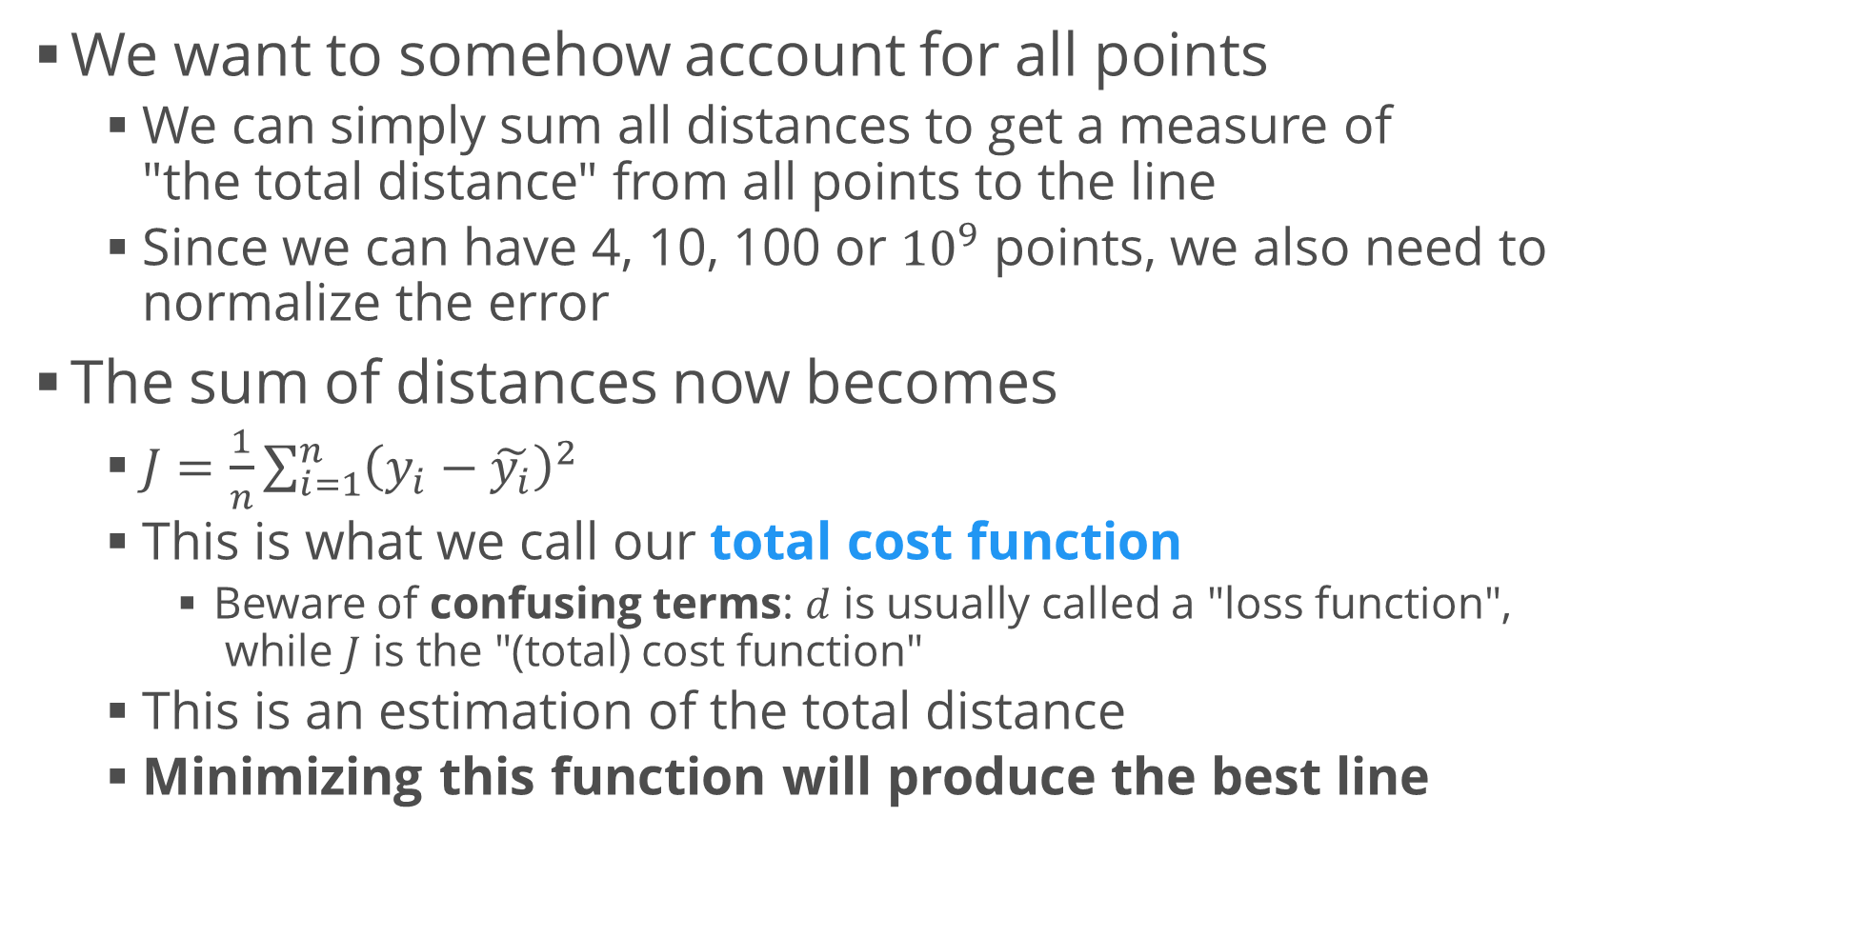
Cost Function
<number>

Slide 16
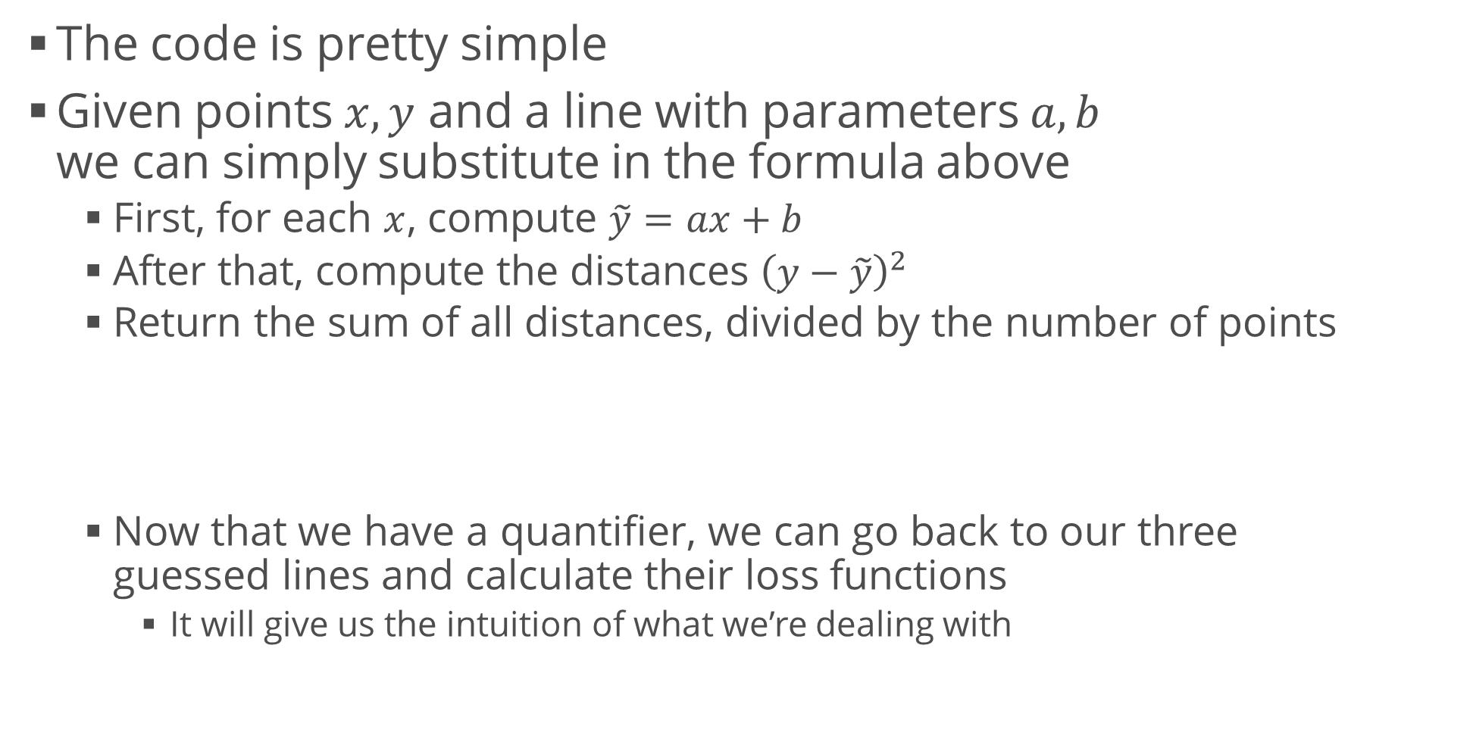
Calculating the Loss Function
def calculate_loss(x, y, a, b):
y_predicted = a * x + b
distances = (y - y_predicted) ** 2
return np.sum(distances) / len(x)
<number>

Slide 17
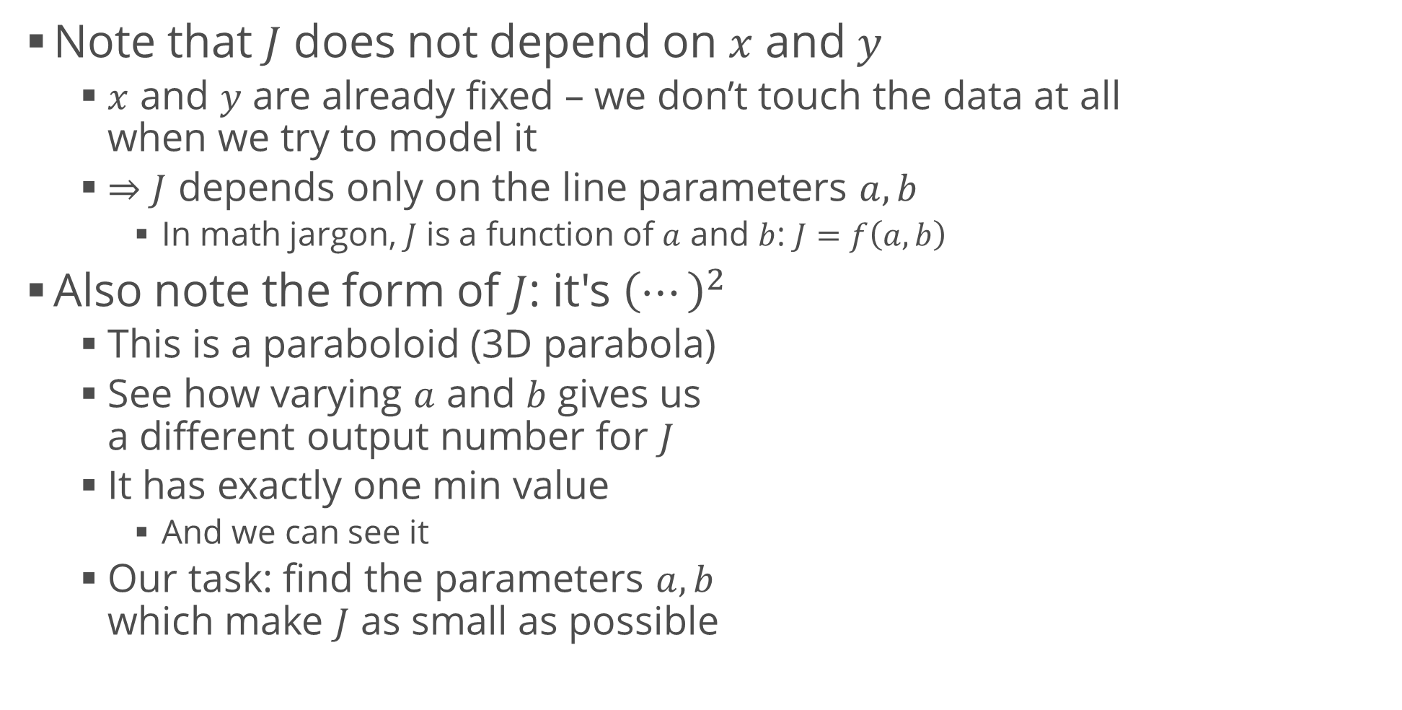
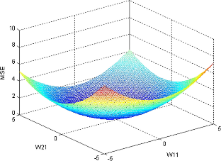
Inspecting the Loss Function
<number>

Slide 18
Minimizing the Loss Function
Intuition
If the plot was a real object (say, a sheet of some sort), we could slide a ball bearing on it
After a while, the ball bearing will settle at the "bottom" due to gravity
We could measure the position of the ball and that's it :)
More "nerd speak"
This is the same task – we have a gravity potential energy that the ball tries to minimize
When it's minimal, the ball remains in stable equilibrium
18

Slide 19
Minimizing the Loss Function (2)
Turns out, we can also do this using calculus
In many dimensions
We can find the optimal parameters right away
Because the function is really simple
But we'll stick to another approach because this is what is useful for all other ML tasks
We'll try to replicate the example with the ball
Basically, we'll try to slide (descend) over the function surface until we reach the minimum
This method is called gradient descent
19

Slide 20
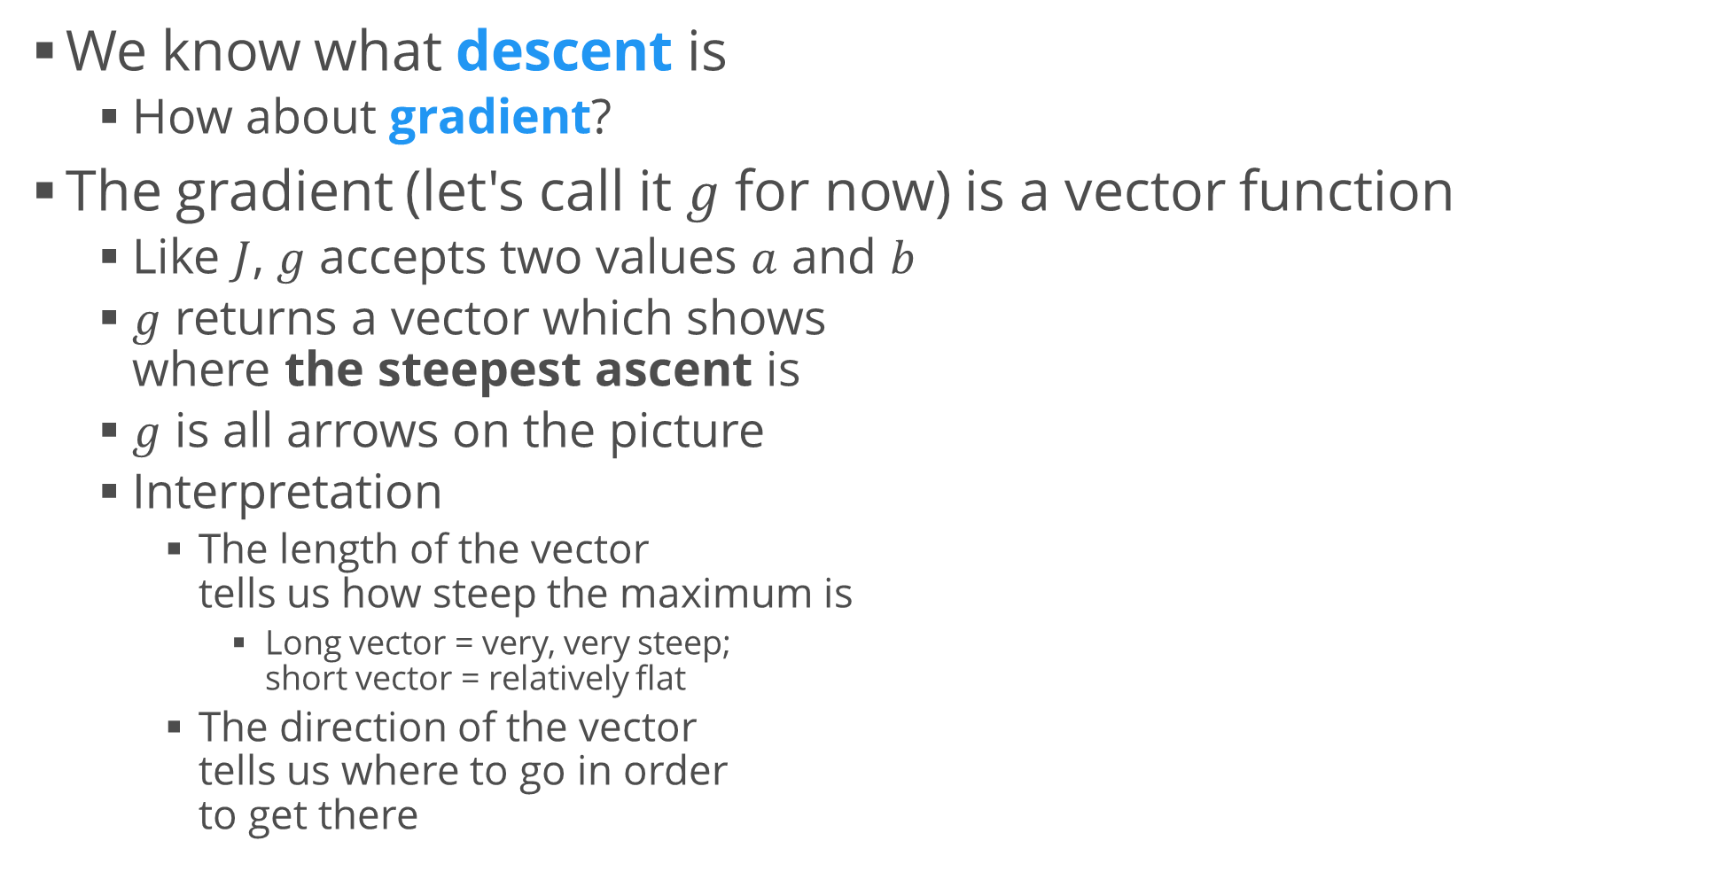
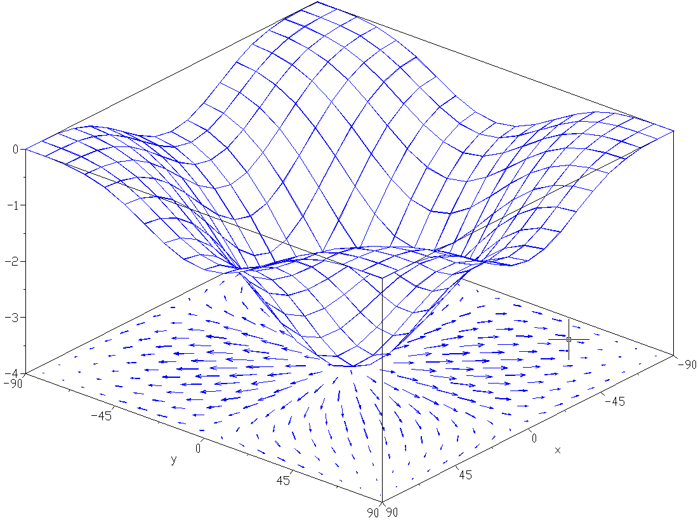
Gradient Descent
19

Slide 21
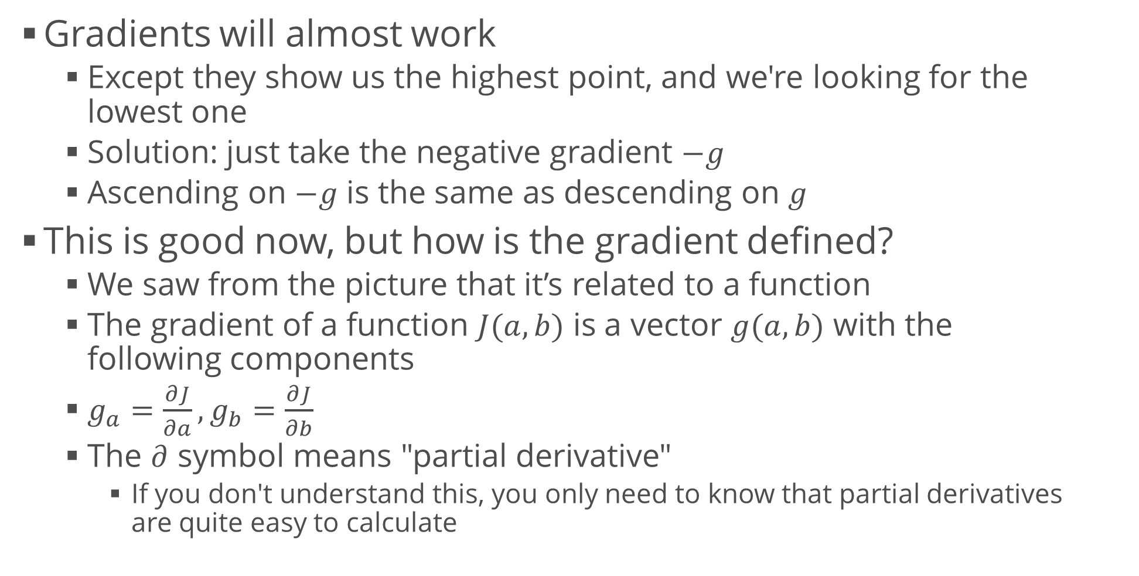
Gradient Descent (2)
<number>

Slide 22
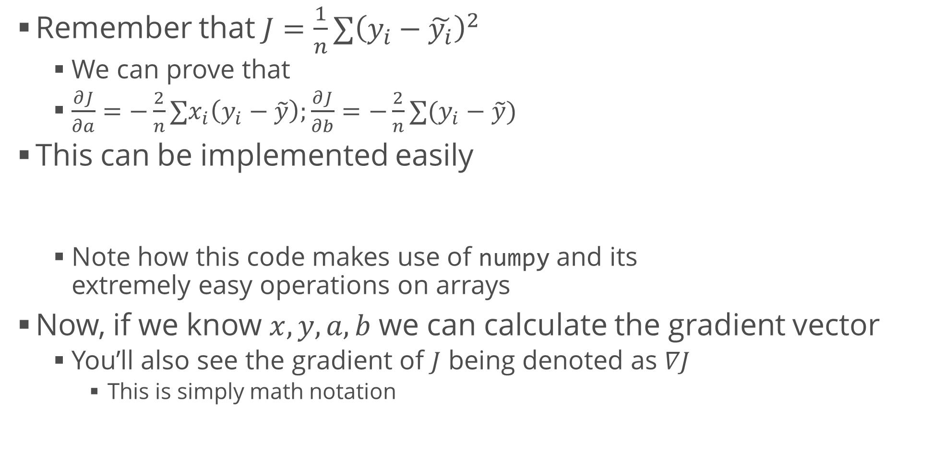
Gradient Descent (3)
a_gradient = -2 / len(x) * np.sum(x * (y - (a * x + b)))
b_gradient = -2 / len(y) * np.sum(y - (a * x + b))
<number>

Slide 23
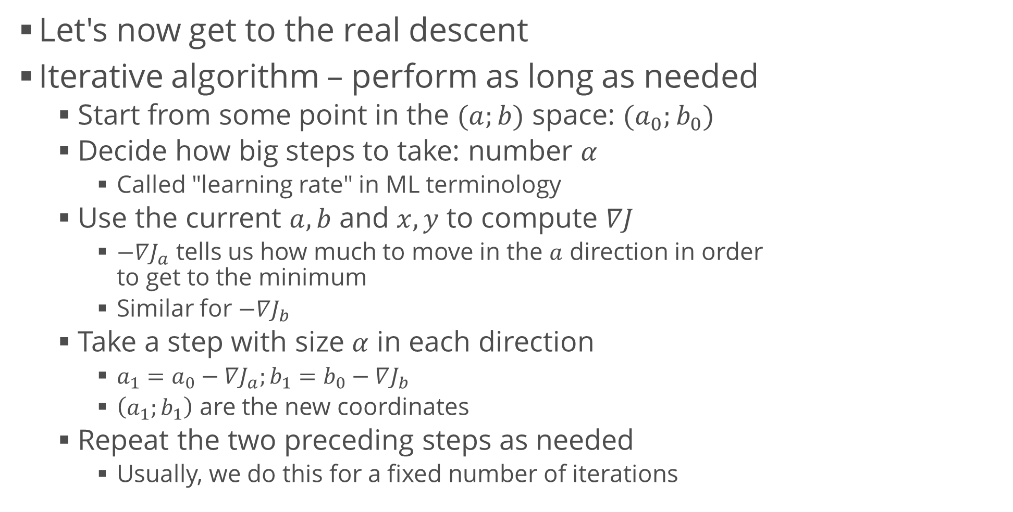
Gradient Descent (4)
<number>

Slide 24
Gradient Descent Code
Gradient descent step
Entire process: 1000 iterations
def perform_gradient_descent(x, y, a, b, learning_rate):
a_gradient = -2 / len(x) * np.sum(x * (y - (a * x + b)))
b_gradient = -2 / len(y) * np.sum(y - (a * x + b))
new_a = a - a_gradient * learning_rate
new_b = b - b_gradient * learning_rate
return (new_a, new_b)
model_a, model_b = -10, 20 # Start points; can be anywhere
alpha = 0.01 # Learning rate for step in range(1001):
model_a, model_b = perform_gradient_descent( data_x, data_y, model_a, model_b, alpha)
if step % 100 == 0:
error = calculate_loss(data_x, data_y, model_a, model_b)
print("Step {}: a = {}, b = {}, J = {}".format( step, model_a, model_b, error))
print("Final line: {} * x + {}".format(model_a, model_b))
24

Slide 25
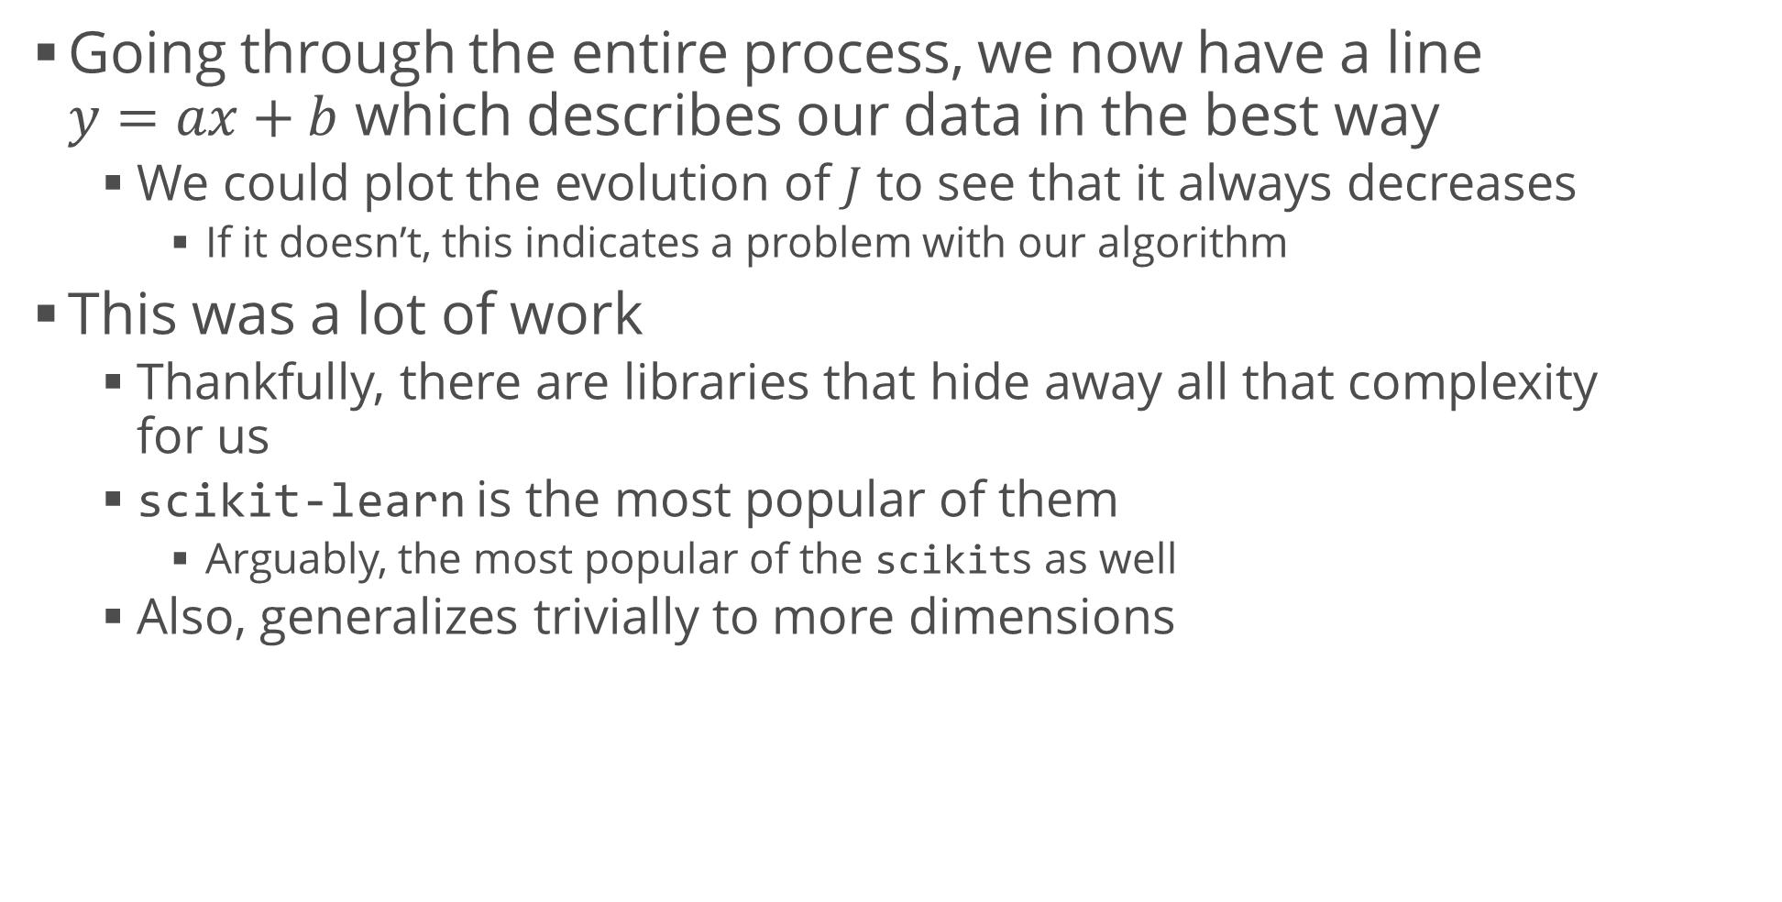
Results and Interpretation
from sklearn.linear_model import LinearRegression
model = LinearRegression()
model.fit(data_x.reshape(-1, 1), data_y)
print(model.coef_, model.intercept_)
24

Slide 26
Logistic Regression
Use a regression model to classify
24

Slide 27
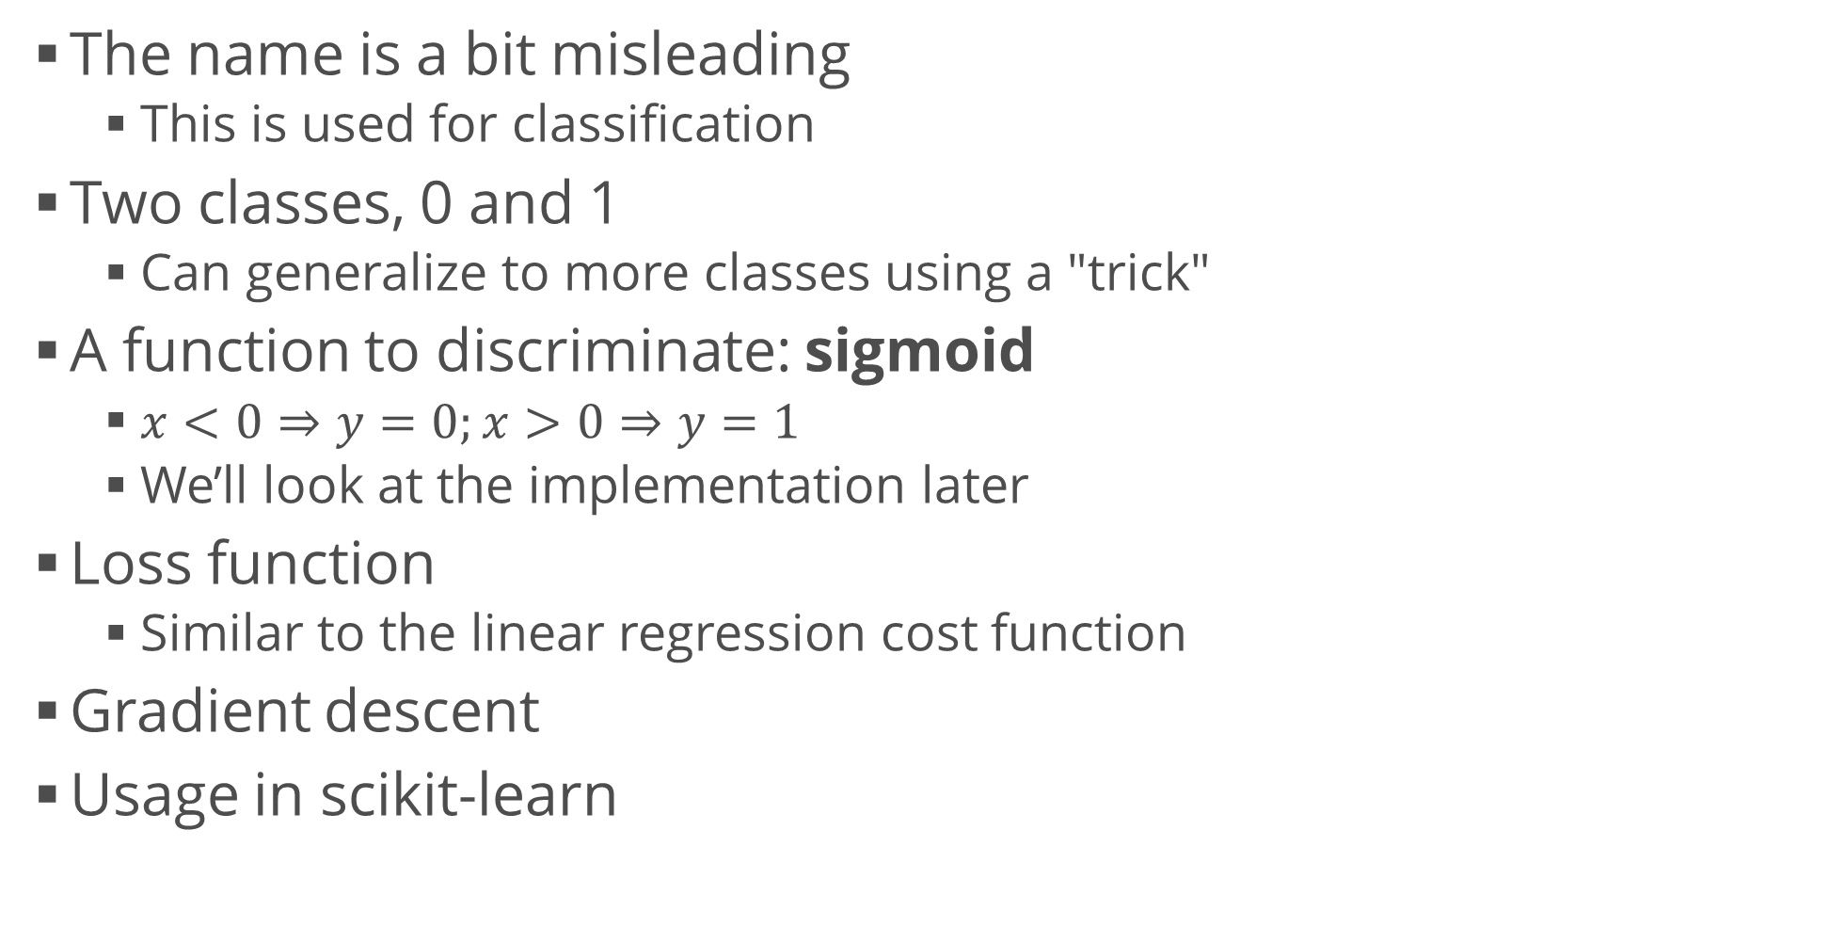
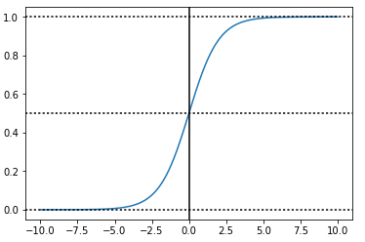
Logistic Regression
from sklearn.linear_model import LogisticRegression
24

Slide 28
Overview of the Process
We dealt mainly with the modelling part
It's only a piece of the puzzle
Many algorithms to choose from
Each with its own features and drawbacks
Many ways to test that we’re on a correct path
The end result depends mainly on
The person working on the dataset
The data quality
Less prominent but also worth mentioning
Data size (bigger is usually better)
Data acquisition and sampling processes
28

Slide 29
Summary
Problem overview
Regression, classification
Machine learning: putting it all together
Linear regression
Motivation, derivation, usage
More involved example
Logistic regression
Motivation, usage

